Slide 1

Using Deep Learning and Graph Analysis against Cyberattacks
Albert Godfrind
Spatial and Graph Solutions Architect
ORACLE Corporation
HROUG Conference 2018
@agodfrin

Slide 2


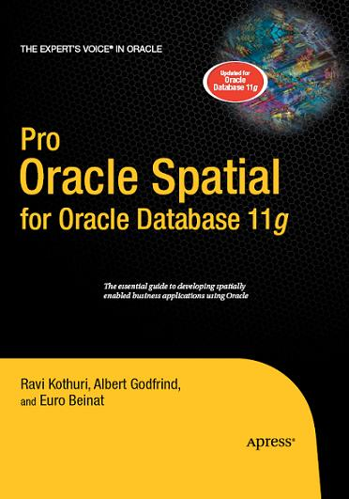
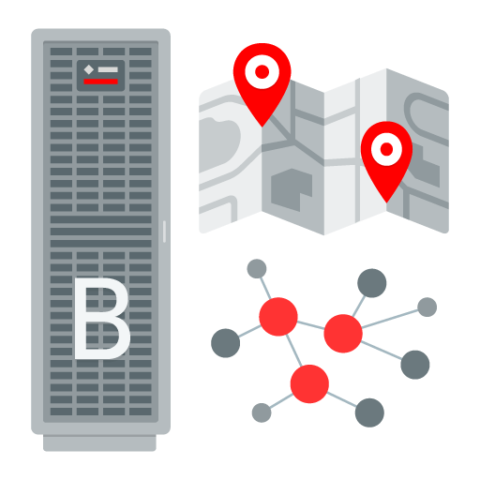
In IT for way too long!
With Oracle for ever
Oracle Spatial Evangelist
Graph Evangelist
Author

Slide 3
Agenda
1
Introduction to graph analysis
Using Oracle‘s graph technologies to work with graphs
Combining graph analysis and machine learning
Using machine learning for network intrusion detection
Wrap-up
2
3
4
5

Slide 4
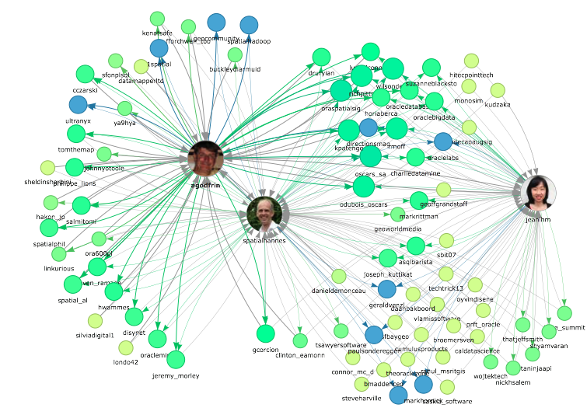
Following, no follow back
Follower, no follow back
Follow each other
https://twitter.jeffprod.com

Slide 5
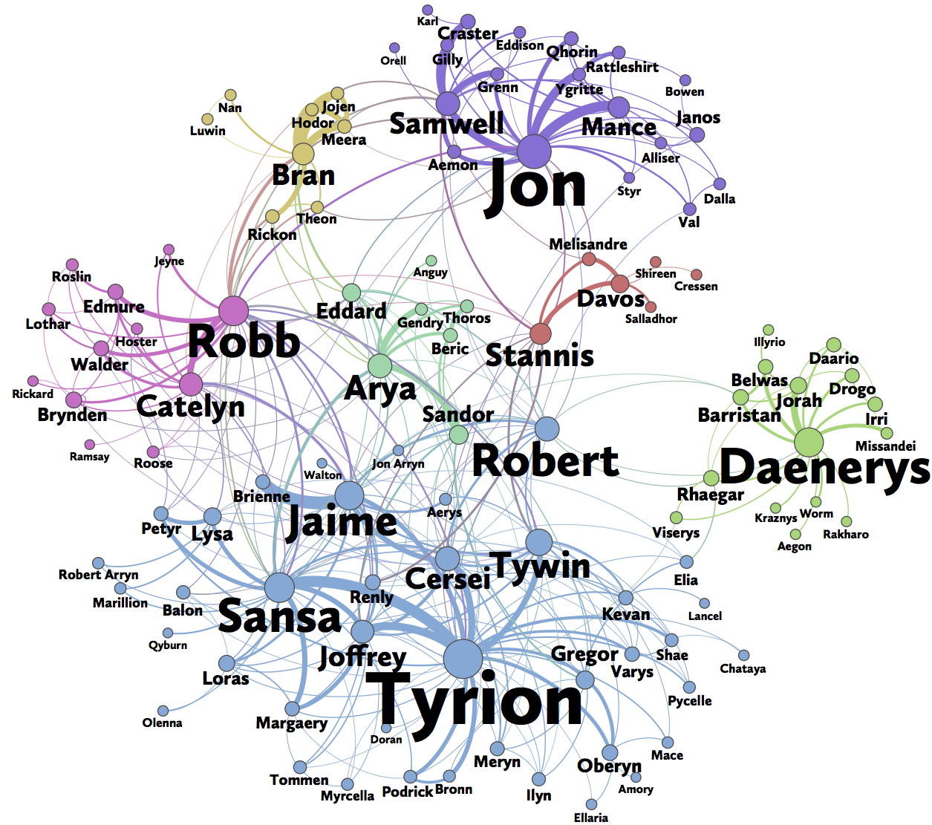
A social network generated from Game of Thrones.
The color of a vertex indicates its community.
The size of a vertex corresponds to its PageRank value, and the size of its label corresponds to its betweenness centrality.
An edge’s thickness represents its weight.
https://www.macalester.edu/~abeverid/thrones.html

Slide 6
Graph Data Model
What is a graph?
  Data model representing entities as vertices and relationships as edges
  Optionally including attributes
  Also known as „linked data“
What are typical graphs?
  Social Networks
    LinkedIn, facebook, Google+, ...
  IP Networks, physical networks, ...
  Knowledge Graphs
    Apple SIRI, Google Knowledge Graph, ...
C
B
A
D
F
E

Slide 7
Graph Data Model
Why are graphs popular?
  Easy data modeling
    „whiteboard friendly“
  Flexible data model
    No predefined schema, easily extensible
    Particularly useful for sparse data
  Insight from graphical representation
    Intuitive visualization
  Enabling new kinds of analysis
    Overcoming some limitations in relational technology
    Basis for Machine Learning (Neural Networks)
C
B
A
D
F
E

Slide 8
Categories of Graph Analysis
Computational Graph Analytics
Graph Pattern Matching
Compute values on vertices and edges
Traversing graph or iterating over graph (usually repeatedly)
Procedural logic
Examples:
  Shortest Path, PageRank, Weakly Connected Components, Centrality, ...
Based on description of pattern
Find all matching sub-graphs
:worksAt{1831}
startDate = ’09/01/2015’
:Person{100}
name = ‘Amber’
age = 25
:Company{777}
name = ‘Oracle’
location =
‘Redwood City’
:friendOf{1173}
:friendOf {2513}
since = ’08/01/2014’
:Person{200}
name = ‘Paul’
age = 30
:knows{2200}
:Person{300}
name = ‘Heather’
age = 27

Slide 9
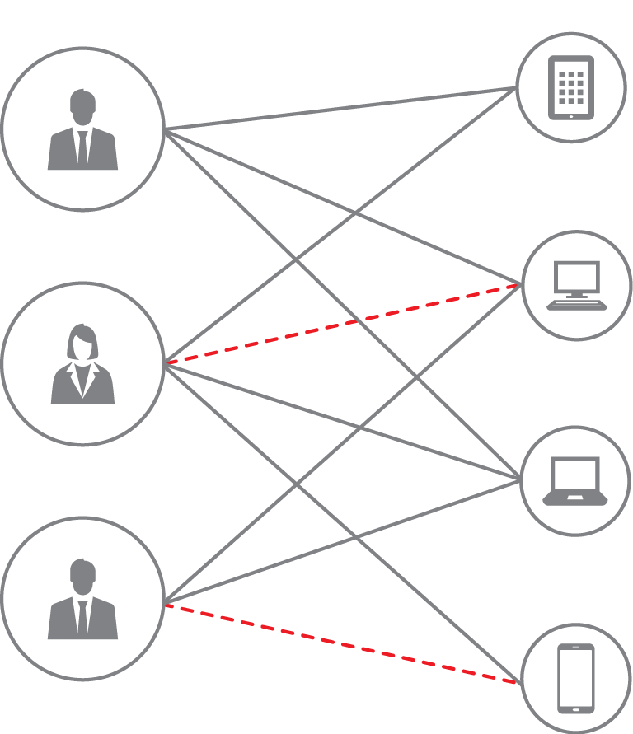
Detecting similarities – Recommentation Engines
Identifying users with similar behaviour or buying pattern
Viewing customer-item relations as large (sparse) matrix
  Customers as one dimension, items as other
Matrix cells filled with rating/rank
  Represent as graph, not as matrix
Collaborative Filtering [1] algorithm solves taste signature of customers, items
  Resulting vectors are like DNA
Inner product of vectors reflects quality of match
[0.305 0.888 0.931 ….]
[0.758 0.331 0.124 …]
[0.758 0.331 0.124 ….]
[0.328 0.172 0.519 ….]
[0.391 0.551 0.223 …]
[0.231 0.119 0.033 ….]
[1] https://en.wikipedia.org/wiki/Collaborative_filtering
[0.112 0.237 0.456 …]

Slide 10
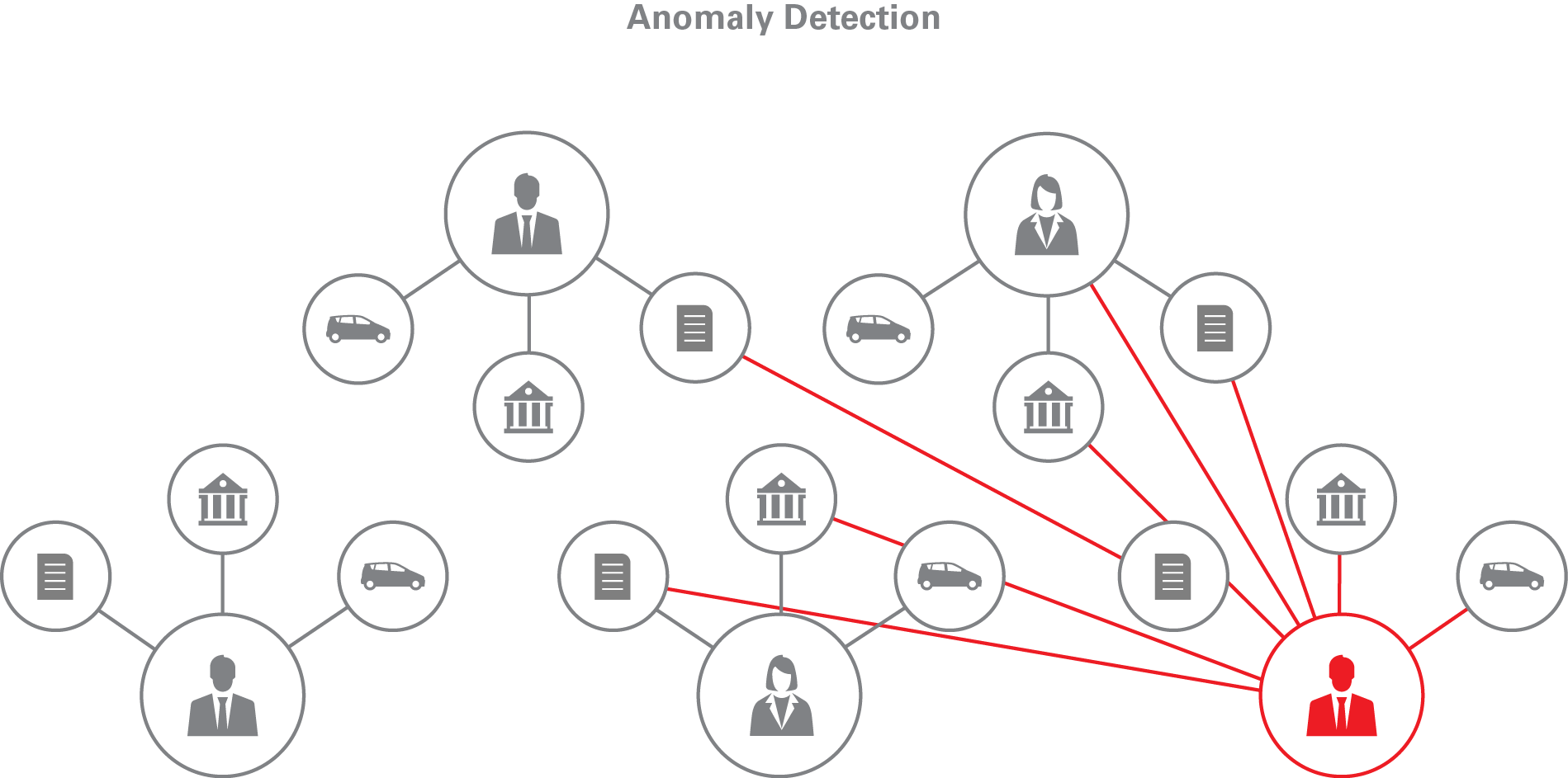
Detecting Outliers – Graph Analysis and Anomaly Detection
Requirement:
  Identify entities from a large dataset that look different than others, especially in their relationships
Approaches:
  Define an anomaly pattern, find all instances of the pattern in the graph
  Given nodes in the same category, find nodes that stand out (eg. low Pagerank value)

Slide 11
Use case: Fraud Detection in Healthcare
Example for potential fraud detection
  Public domain dataset
  Medical providers and their operations
Question
  Are there any medical providers that are suspicious
  medical providers that perform different operations than their fellows
  (e.g. eye doctors doing plastic surgery)
Approach
  Create graph between doctors and operations
  Apply personalized pagerank (a.k.a equivalent to random walking)
  Identify doctors that are far from their fellows
Clinics
(doctors)
Operations

Slide 12
Agenda
1
Introduction to graph analysis
Using Oracle‘s graph technologies to work with graphs
Combining graph analysis and machine learning
Using machine learning for network intrusion detection
Wrap-up
2
3
4
5

Slide 13
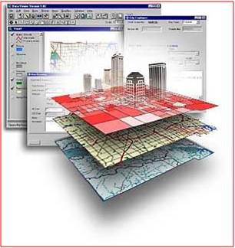

Introducing: Oracle Big Data Spatial and Graph
Spatial Analysis:
Location Data Enrichment
Proximity and containment analysis, Clustering
Spatial data preparation (Vector, Raster)
Interactive visualization
Property Graph Analysis:
Graph Database
In-memory Analysis Engine
  Scalable Network Analysis Algorithms
  Developer APIs
Notes:
cf. AVEA presentation (Hüsnü) – creating heat map with customer locations from XDR data, could associate with location hierarchy and conflate with socio-demographic or other 3rd party data for example

Slide 14
In-memory Analytics Engine – Product Packaging
Oracle Big Data Spatial and Graph
Oracle Spatial and Graph (DB option)
Available for Big Data platform
  Hadoop, HBase, Oracle NoSQL
Supported both on BDA and commodity hardware
  CDH and Hortonworks
Database connectivity through Big Data Connectors or Big Data SQL
Included in Big Data Cloud Service
Available with Oracle 12.2 (EE)
Using tables for graph persistence
In-database graph analytics
  Sparsification, shortest path, page rank, triangle counting, WCC, sub graph generation…
SQL queries possible
  Integration with Spatial, Text, Label Security, RDF Views, etc.

Slide 15
Architecture of Property Graph
REST/Web Service
APIs
Java, Groovy, Python, …
Graph Analytics
Property Graph formats
Parallel In-Memory Graph Analytics
GraphML
GML
Graph-SON
Flat Files
Graph Store Management
RDF (RDF/XML, N-Triples, N-Quads, TriG,N3,JSON)
Blueprints/Tinkerpop/Gremlin
Scalable and Persistent Storage Management
Oracle RDBMS
Apache HBase
Oracle NoSQL Database

Slide 16
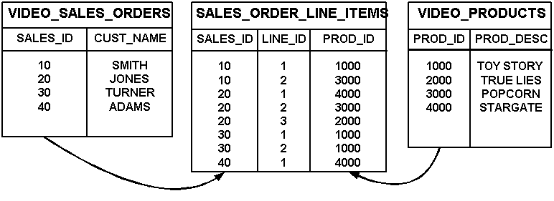
Creating a Graph
From a relational model
  Rows in tables usually become vertices
  Columns become properties on vertices
  Relationships become edges
  Join tables in n:m relations are transformed into relationships, columns become properties on edges
Interactively through API or graphical tool
  Adding vertices, edges, properties to a given graph
From graph exchange formats
  GraphML, GraphSON, GML (Graph Modeling Language)

Slide 17
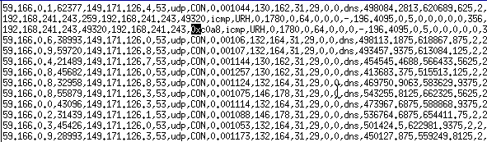
Creating a Graph from Network Traffic
Capture network traffic (source/target IP address and port, protocol, state, duration, ...)
Model each IP address as vertex
Model each record (from source IP to destination IP) as an edge
Attributes can become properties on the edge
Utilities available to convert CSV to graph
  OraclePropertyGraphUtilsBase.convertCSV2OPV
  OraclePropertyGraphUtilsBase.convertCSV2OPE

Slide 18
Agenda
1
Introduction to graph analysis
Using Oracle‘s graph technologies to work with graphs
Combining graph analysis and machine learning
Using machine learning for network intrusion detection
Wrap-up
2
3
4
5

Slide 19
Combining Graph Analytics and Machine Learning
Graph Analytics
Machine Learning
Compute graph metric(s)
Explore graph or compute
new metrics using ML result
Build predictive model
using graph metric
Build model(s) and
score or classify data
Add to
structured data
Add to graph

Slide 20




Using Oracle R Enterprise for Machine Learning
Use Oracle Database as a high performance compute environment
Transparency layer
  Leverage proxy objects (ore.frames) - data remains in the database
  Overload R functions that translate functionality to SQL
  Use standard R syntax to manipulate database data
Parallel, distributed ML algorithms
  Scalability and performance
  Exposes in-database machine learning algorithms from ODM
  Additional R-based algorithms executing and database server
Embedded R execution
  Store and invoke R scripts in Oracle Database
  Data-parallel, task-parallel, and non-parallel execution
  Invoke R scripts at Oracle Database server from R or SQL
  Use open source CRAN packages
SQL Interfaces
R Client
SQL*Plus,
SQLDeveloper, …
Oracle R Enterprise
Oracle Database
Database
Server
Machine
In-db
stats
User tables

Slide 21

One option: OAAgraph integration with R
OAAgraph integrates in-memory engine into ORE and ORAAH
Adds powerful graph analytics and querying capabilities to existing analytical and machine learning portfolio of ORE and ORAAH
Built-in algorithms of PGX available as R functions
PGQL pattern matching
Concept of “cursor” allows browsing of in-memory analytical results using R data structures (R data frame), allows further client-side processing in R
Exporting data back to Database / Spark allows persistence of results and further processing using existing ORE and ORAAH analytical functions

Slide 22


OAAgraph Architecture
OAAgraph gives remote control of PGX server
PGX loads graph from database (ore.frames)
R Client
PGX Server
(Spatial and Graph)
ORE
OAAgraph
Oracle Database
Client
OAAgraph is an additional R package that comes with ORE
Database Server

Slide 23

OAAgraph Architecture
OAAgraph gives remote control of PGX server
PGX loads graph via SPARK data frames
PGX Server
(Big Data Spatial & Graph)
R Client
ORAAH
Hadoop & Spark
OAAgraph
Client
HDFS / Hive / …
OAAgraph is also available with ORAAH
Oracle Big Data (Hadoop) Cluster

Slide 24
Execution Overview (ORE)
Initialization and Connection
R Client
PGX Server
ORE
OAAgraph
Oracle Database
Client
# Connect R client to
# Oracle Database using ORE
R> ore.connect(..)
R> oaa.init(..)
Database Server
# Connect to PGX server
# using OAAgraph
R> oaa.graphConnect(...)

Slide 25
Execution Overview (ORE)
Data Source
  Graph data is represented as two tables
    Nodes and Edges
  Multiple graphs can be stored in database
    Using user-specified, unique table names
PGX Server
Oracle Database
Node Table
Edge Table
Node ID | Node Prop 1 (name) | Node Prop 2 (age) | …
1238 | John | 39 | …
1299 | Paul | 41 | …
4818 | … | … | …
From Node | To Node | Edge Prop 1 (relation) | …
1238 | 1299 | Likes | …
1299 | 4818 | FriendOf | …
1299 | 6637 | FriendOf | …
node
edge
node
edge
Database Server

Slide 26
Execution Overview (ORE)
Loading Graph
R Client
PGX Server
ORE
OAAgraph
Oracle Database
Client
node
edge
# Load graph into PGX:
# Graph load happens at the server side.
# Returns OAAgraph object, which is a
# proxy (remote handle) for the graph in PGX
R> mygraph <-
oaa.graph (NodeTable, EdgeTable, ...)
Database Server

Slide 27
Execution Overview (ORE)
Running Graph Algorithm
R Client
PGX Server
ORE
OAAgraph
Oracle Database
Client
# e.g. compute Pagerank for every node in the graph
# Execution occurs in PGX server side
R> result1<- pagerank (mygraph, ... )
Database Server

Slide 28
Execution Overview (ORE)
Iterating remote values with cursor
pagerank
R Client
PGX Server
ORE
OAAgraph
Oracle Database
Client
# e.g. compute Pagerank for every node in the graph
# Execution occurs in PGX server side
R> result1<- pagerank (mygraph, ... )
# Return value is a “cursor” object
# for the computed result:
# client can get local data frames by oaa.next()
R> df <- oaa.next(result1, 10)
Database Server

Slide 29
Execution Overview (ORE)
y
w
x
0.01
Querying the graph
0.2
0.05
z
R Client
0.001
PGX Server
ORE
OAAgraph
Client
Oracle Database
# Query graph using a SQL syntax pattern specification
R> q_result <- oaa.cursor(mygraph,
“SELECT n.name, m.name, n.pagerank, m.pagerank
WHERE (n WITH pagerank < 0.1) -> (m),
n.pagerank > m.pagerank
ORDER BY n.pagerank”
)
# Returns a cursor to examine results
R> df <- oaa.next(q_result, 10)
Database Server

Slide 30
Execution Overview (ORE)
Exporting the result to DB
R Client
PGX Server
ORE
OAAgraph
Oracle Database
Client
# Export result to DB as Table(s)
R> oaa.create(mygraph, nodeTableName = “node”,
nodeProperties = c(“pagerank“, … ),
… )
node
edge
Database Server

Slide 31
Execution Overview (ORE)
Continuing analysis with ORE
R Client
PGX Server
ORE
OAAgraph
Oracle Database
Client
# Use ORE Machine Learning on
# the exported table proxy object ore.frames
R> model <- ore.odmKMmeans(formula = ~.,
data = NODES,
num.centers = 5,…)
R> scores <- predict(model, NODES, …)
…
node
edge
Database Server

Slide 32
Agenda
1
Introduction to graph analysis
Using Oracle‘s graph technologies to work with graphs
Combining graph analysis and machine learning
Using machine learning for network intrusion detection
Wrap-up
2
3
4
5

Slide 33
Use case: Network Intrusion Detection
Using deep learning and graph analysis
Determining if network activity is legitimate or fraudulent
  Based on sequence of network activity (as above)
  Complementary to firewalls, network intrusion prevention system, ...
Possible approaches
  „Signature-based“, using labeled dataset of known attacks (supervised learning)
  Anomaly-based, trying to detect previously unseen attacks
Most effective systems make use of both
  Combined with rules engine
Tested supervised learning in project using DL4J

Slide 34
Supervised learning
Training dataset
Labeled Network data set from Univ. of South Wales
  UNSW-NB15 data set specifically created for Network Intrusion Detection systems
  Generated by IXIA PerfectStorm tool in Cyber Range Lab of Australian Centre for Cyber Security
  Real modern normal activities plus synthetic contemporary attack behaviours
  Partitioned into training set (175K records) and testing set (82K records)
  nine types of attacks – Fuzzers, Analysis, Backdoors, DoS, Exploits, Generic, Reconnaissance, Shellcode and Worms
Moustafa, Nour, and Jill Slay. "UNSW-NB15: a comprehensive data set for network intrusion detection systems (UNSW-NB15 network data set)."Military Communications and Information Systems Conference (MilCIS), 2015. IEEE, 2015.
Moustafa, Nour, and Jill Slay. "The evaluation of Network Anomaly Detection Systems: Statistical analysis of the UNSW-NB15 data set and the comparison with the KDD99 data set." Information Security Journal: A Global Perspective (2016): 1-14.

Slide 35
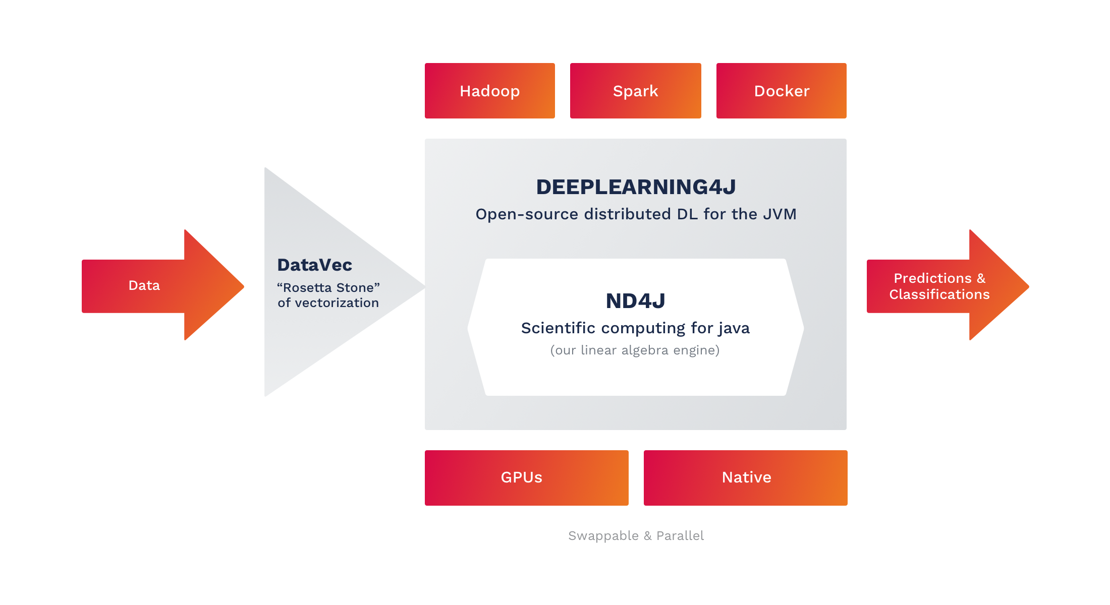
Prototype with Skymind and DeepLearning4J
Graph Database (BDSG and Oracle Spatial and Graph)
Graph Database (BDSG and Oracle Spatial and Graph)

Slide 36
Processing Workflow
Understanding the dataset
  49 features in each record – IP addresses, integer, float, timestamp, ...
Data cleansing
  Converting Hex to number
Creating vector as input to DL4J deep learning engine
  Categorical to One Hot transformation of status strings
Build Neural Network
  Train and subsequently test quality using testing set
Transfer result to graph database
  Further analysis

Slide 37
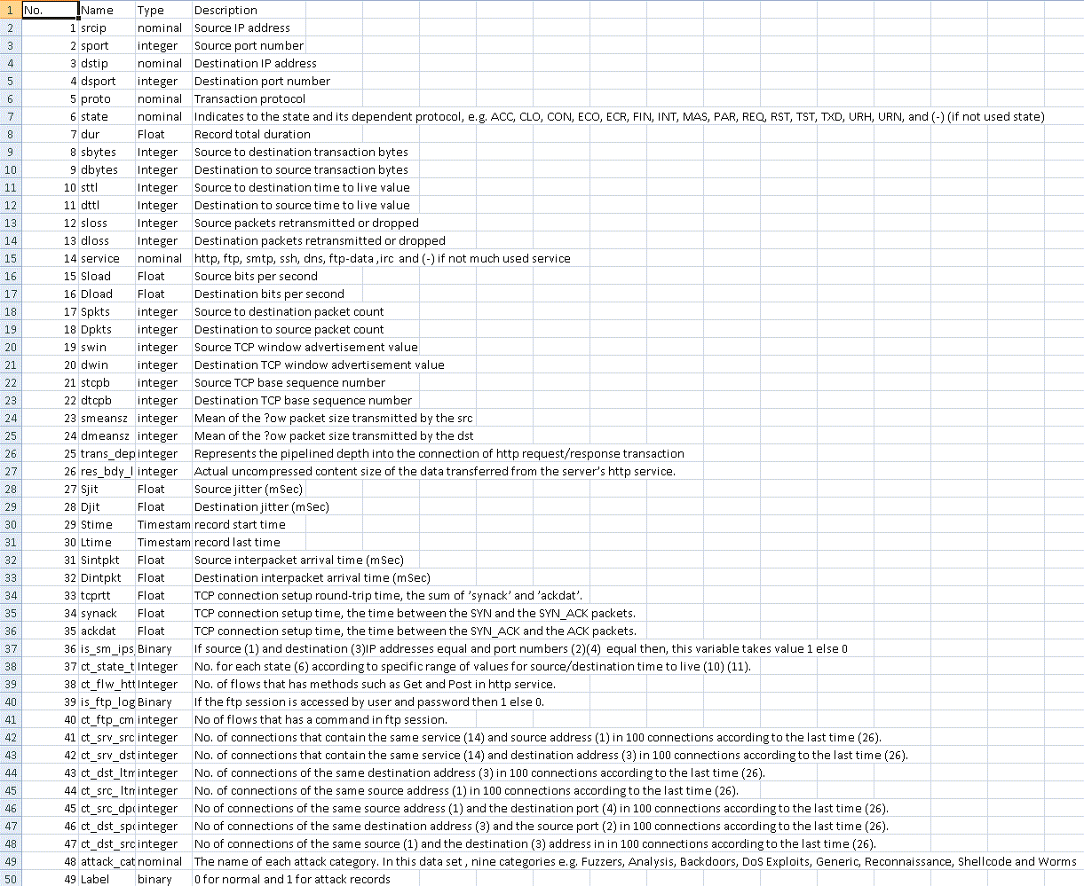
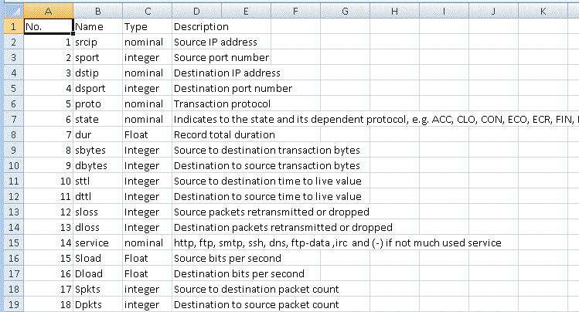
Dataset
selection
Data Cleansing
&
preparation
Load
Property Graph
into BDSG
Graph
Visualization
Train Neural Network model
Generate
Property Graph
Understand the data
  Features of UNSW-NB15 data set
49 original
features

Slide 38
Dataset
selection
Data Cleansing
&
preparation
Load
Property Graph
into BDSG
Graph
Visualization
Train Neural Network model
Generate
Property Graph
One round of clean up.
  Ports should be all integer based, however, there are Hex values
  Action: convert them back to decimal

Slide 39
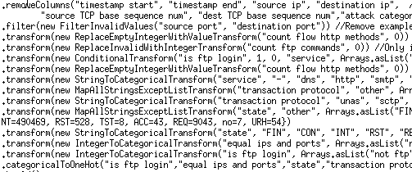
Dataset
selection
Data Cleansing
&
preparation
Load
Property Graph
into BDSG
Graph
Visualization
Train Neural Network model
Generate
Property Graph
Understand the data & define transformations
Service “dns” becomes 0 1 0 0 0 0 0 0 0 0 0 0 0
Categorical to One Hot transformation

Slide 40
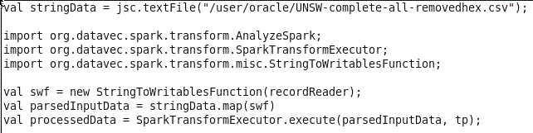
Dataset
selection
Data Cleansing
&
preparation
Load
Property Graph
into BDSG
Graph
Visualization
Train Neural Network model
Generate
Property Graph
Executed transformations with Scala & Apache Spark using Oracle’s Big Data stack
Save the RDD back to CSV format

Slide 41
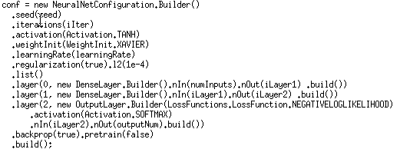
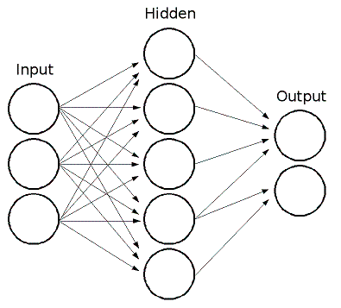
Dataset
selection
Data Cleansing
&
preparation
Load
Property Graph
into BDSG
Graph
Visualization
Train Neural Network model
Generate
Property Graph
Built a Multi-Layer Perceptron (MLP) Neural Network

Slide 42
Dataset
selection
Data Cleansing
&
preparation
Load
Property Graph
into BDSG
Graph
Visualization
Train Neural Network model
Generate
Property Graph
Tested the quality of MLP NN
  After 800 iterations of training
    Accuracy: 0.9811
    Precision: 0.9894
    Recall: 0.9286
    F1 Score: 0.958
  Labeled as “non-intrusion” classified as “non-intrusion”: 46 times
  Labeled as “intrusion” classified as “non-intrusion”: 1 time
  Labeled as “intrusion” classified as “intrusion”: 6 times ((46+6)/(46+6+1) = 0.9811)
Long Short-Term Memory (LSTM) NN gave similar F1 result

Slide 43
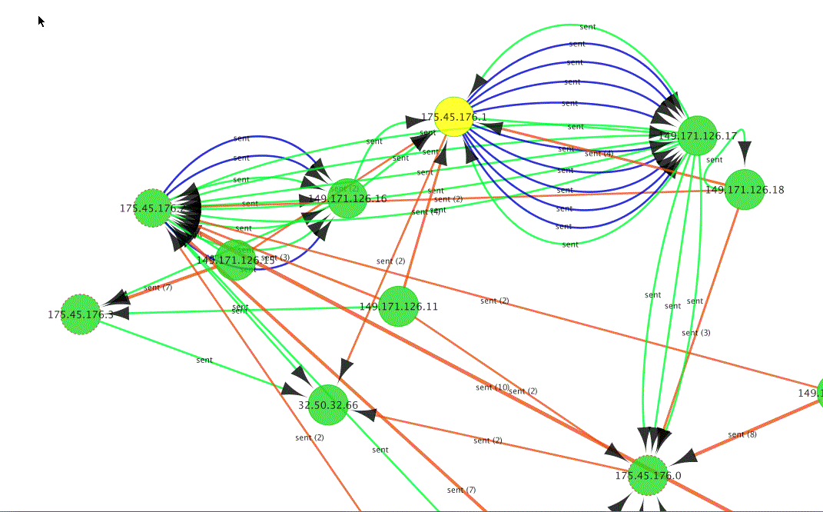
Dataset
selection
Data Cleansing
&
preparation
Load
Property Graph
into BDSG
Graph
Visualization
Train Neural Network model
Generate
Property Graph
Network Intrusion Detection
Property Graph
  Blue edges: malicious
  Other edges: normal traffic
Many attacks originated from
175.45.176.1 to target
149.171.126.17
Visualization tool: Cytoscape v3.2.1
+ Big Data Spatial and Graph v2.1

Slide 44
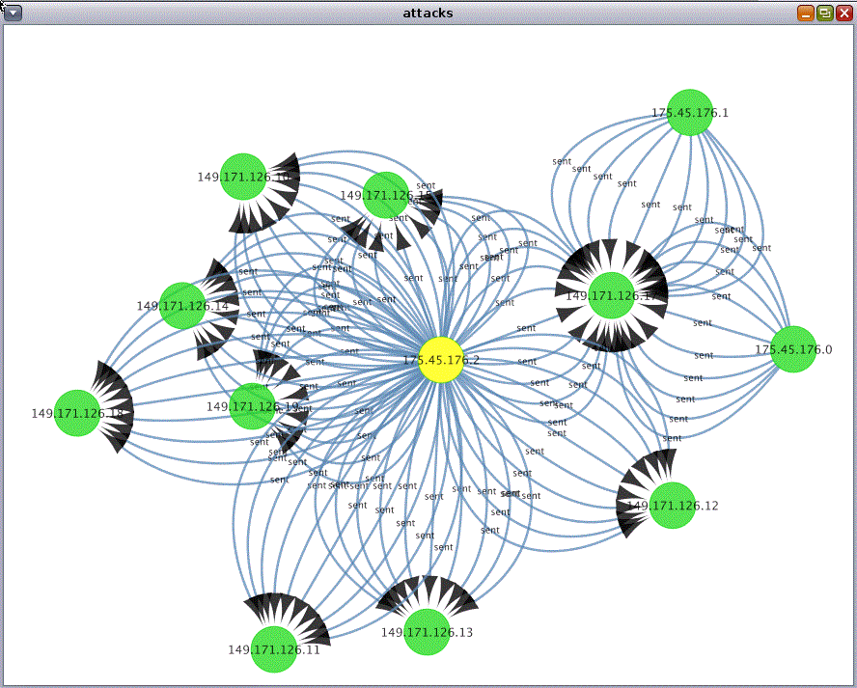
Dataset
selection
Data Cleansing
&
preparation
Load
Property Graph
into BDSG
Graph
Visualization
Train Neural Network model
Generate
Property Graph
Focused on “Attacks” graph

Slide 45
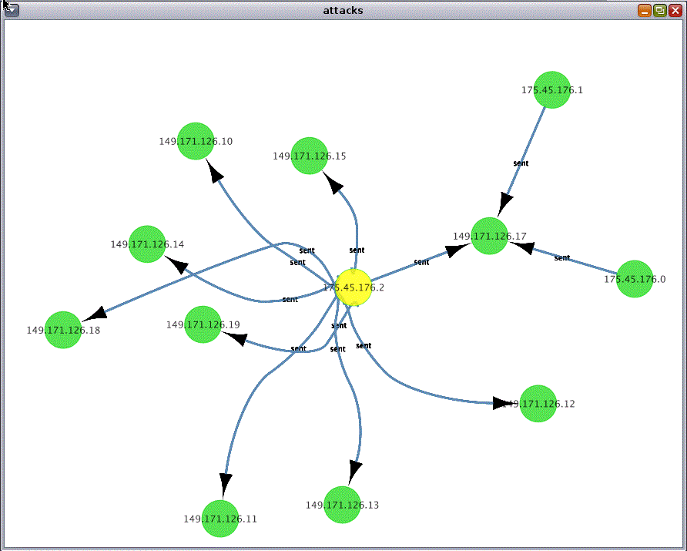
Dataset
selection
Data Cleansing
&
preparation
Load
Property Graph
into BDSG
Graph
Visualization
Train Neural Network model
Generate
Property Graph
Focused on “Attacks” graph

Slide 46
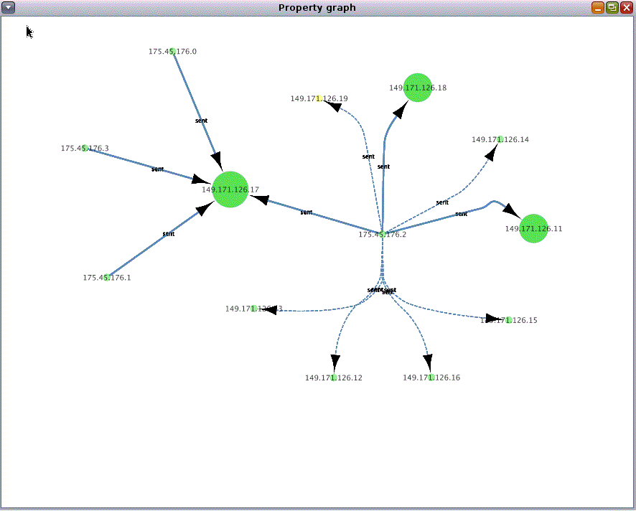
Dataset
selection
Data Cleansing
&
preparation
Load
Property Graph
into BDSG
Graph
Visualization
Train Neural Network model
Generate
Property Graph
Focused on “Attacks” graph
Applied built-in analytics in BDSG
Found top-3 IP addresses with highest Page Rank value

Slide 47
Wrap-up

Slide 48

Summary
Graph analytics and machine learning
Graph databases are powerful tools, complementing machine learning technologies
  Especially strong for analysis of graph topology and multi-hop relationships
Graph analytics offer new insight which can be used as input to machine learning
  Especially relationships, dependencies and behavioural patterns
Oracle Big Data Spatial and Graph and Oracle 12.2 Spatial and Graph offer
  Comprehensive analytics through various APIs
  Scaleable, parallel in-memory processing about 50 graph algorithms pre-built
  Integration with R, integration with SPARK, integration with relational database
  Secure and scaleable graph storage on Hadoop using Oracle NoSQL or HBase or Oracle database
Running both on-premise or in the Cloud

Slide 49



Resources
Oracle Big Data Spatial and Graph OTN product page:
www.oracle.com/technetwork/database/database-technologies/bigdata-spatialandgraph
  White papers, software downloads, documentation and videos
Oracle Big Data Lite Virtual Machine - a free sandbox to get started:
www.oracle.com/technetwork/database/bigdata-appliance/oracle-bigdatalite-2104726.html
Hands On Lab included in /opt/oracle/oracle-spatial-graph/
  Content also available on GITHub under http://github.com/oracle/BigDataLite/
Blog – examples, tips & tricks: blogs.oracle.com/bigdataspatialgraph
@OracleBigData, @SpatialHannes, @agodfrin, @JeanIhm
Oracle Spatial and Graph Group
Notes:
Here are various resources for more information on the Big Data Spatial and Graph product.
Our product pages include data sheets, trial downloads, documentation
The Big Data Lite VM is a free sandbox environment that you can download to quickly get started using Oracle’s Big Data platform components including Big Data Spatial and Graph, Oracle Database, and several other technologies – also a great way to get your feet wet
You can also find a Hands on Lab where you can work with the vector and raster features we’ve shown today
Check out the blog for examples and code samples
We’re on social media at these handles
Finally, if you are planning to attend the Oracle OpenWorld 2016 conference in San Francisco this fall, we’ll have a number of sessions, labs, and demos around the big data and cloud technologies.

Slide 50

Interested in project experience, best practices, networking?
Spatial and Graph Summit
IOUG Business Intelligence, Warehousing and Analytics SIG have established annual BIWA Summit
  Rebranded as Analytics and Data Summit
  Planned for March 12 – 14, 2019 at OracleHQ
Spatial and Graph Summit is separate track
  Lots of interesting material from previous
  years available on OTN
Opportunity for interaction with
Spatial PM and Dev‘t team

Slide 51
Q&A

Slide 52


ALBERT GODFRIND
Spatial and Graph Solutions Architect
Oracle Corporation
Les Algorithmes
2000 Route des Lucioles
06410 Biot-Sophia-Antipolis
France
phone +33 4 37.43.47.27
mobile +33 6 09.97.27.23
albert.godfrind@oracle.com
http://www.oracle.com/

