Slide 1

Making Sense of Location: Tracking, Visualizing & Analyzing Moving Objects in 2D, 3D & 4D
Location Intelligence On-premise and in the Cloud
Albert Godfrind
Spatial and Graph Solutions Architect
ORACLE Corporation
HROUG Conference 2018
@agodfrin

Slide 2


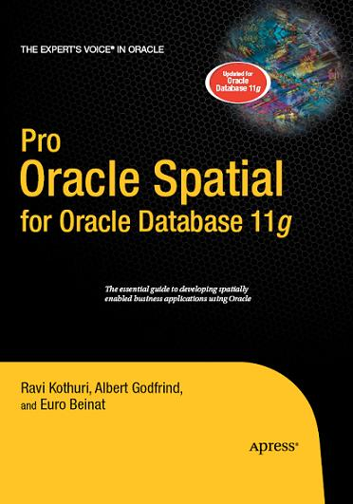
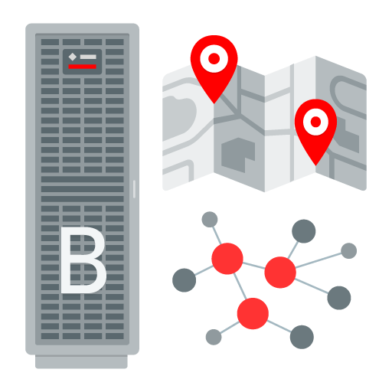
In IT for way too long!
With Oracle for ever
Oracle Spatial Evangelist
Graph Evangelist
Author

Slide 3

Tracking and Tracing – Analysis of Moving Objects
Lots of use cases involving moving objects transmitting location data
  Smart Cities, Public Transport, Traffic Services, ...
  Internet of Things (IoT)
  Industry 4.0 / Supply Chain Management
  Location-based Services, eg. Targeted Marketing based on location of consumer

Slide 4
Agenda
1
Geospatial Data in the Database
Using the Database for Tracking and Tracing
Visualizing Results on a Map
Advanced Analysis using Road Networks
Stream Analytics and Event-driven Architectures
2
3
4
5

Slide 5

What is Spatial Data
Integral part of almost every database
Business data that contains or describes location
  Geographic features (roads, rivers, parks, etc.)
  Assets (pipe lines, cables, transformers,
  Sales data (sales territory, customer registration, etc.)
  Street and postal address (customers, stores, factories, etc.)
Anything associated with a physical location
Described by coordinates or implicitly as text (place name), ...
Location is a “universal key” relating otherwise unrelated entities

Slide 6
Required database capabilities for geospatial analysis
Data type to store points, lines, areas, solids, ...
  In two or three dimensions
  Taking into account coordinate system
Topological Operators
  Point-in-polygon, intersecting linestrings, overlapping areas, ...
Geometric Functions
  Calculating areas, distances, buffer zones, ...
Spatial Indices
  Fast access to relevant data

Slide 7
Storing spatial data in SDO_GEOMETRY
Table Counties
ID NAME BOUNDARY
NUMBER VARCHAR2 SDO_GEOMETRY
SDO_GTYPE NUMBER
SDO_SRID NUMBER
SDO_POINT SDO_POINT_TYPE
SDO_ELEM_INFO SDO_ELEM_INFO_ARRAY
SDO_ORDINATES SDO_ORDINATE_ARRAY

Slide 8
Creating Geometric Objects
Creating point data ...
Alternatively ...
select sdo_geometry('POINT (10 50)', 4326) from dual;
SDO_GEOMETRY
------------------------------------------------------------------
SDO_GEOMETRY(2001, 4326, SDO_POINT_TYPE(10, 50, NULL), NULL, NULL)
select sdo_geometry(2001, 4326, sdo_point_type(10,50,null), null, null) from dual;
SDO_GEOMETRY
------------------------------------------------------------------
SDO_GEOMETRY(2001, 4326, SDO_POINT_TYPE(10, 50, NULL), NULL, NULL)

Slide 9
Accessing Coordinates in SDO_GEOMETRY
Which points describe the boundary of Germany?
SQL> select k.id, k.x, k.y from
2 countries c,
3 table(sdo_util.getvertices(c.geometry)) k
4 where country_name='GERMANY';
ID X Y
---------- ---------- ----------
1 14,7200450 51,582406
2 14,7554651 51,603937
3 14,7570239 51,644129
: : :

Slide 10
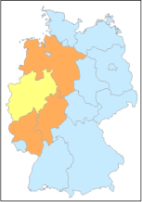
Example: Spatial SQL Queries
Which German Länder are touching North-Rhine Westphalia?
Using spatial (R-Tree) index for query optimization
  Two-step filter process
  Checking interaction between minimum bounding rectangle first, then detailed test
select l1.name
from laender l1, laender l2
where l2.name='NRW' and
sdo_relate(
l1.boundary, l2.boundary,
'mask=touch'
)='TRUE'

Slide 11
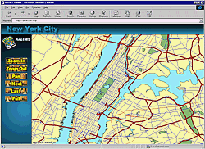
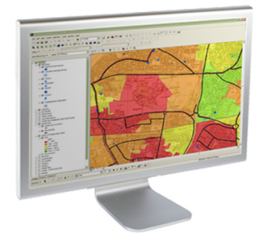


Geospatial Product Portfolio
Cloud or on-premise Map services
Oracle Database
  Basic capabilities for spatial data management
Oracle Spatial and Graph
  Priced option for Geocoding, Routing, High-Performance Query and Analytics, and more
  Includes RDF Graph capabilities (triple store, SPARQL queries, inferencing and ontology support, ...)
  Includes property graph analytics engine
Oracle Fusion Middleware MapViewer
  Java-based map rendering engine built on HTML5
Big Data and NoSQL support
Built on open standards (OGC, ISO 191xx, ...)
Partnerships with data providers, SIs, ISVs, ...
HTTP
Oracle Fusion Middleware
MapViewer
JDBC
Oracle Database
Spatial and Graph Option
Local Map
content
11

Slide 12



Multi-model Database or Big Data Platform
Available on-premise or as Cloud Services
Oracle Big Data Spatial and Graph
Oracle Database
Spatial and Graph
Spatial and Graph in Cloud Offerings
NoSQL
Big Data:
Single Model Data Store
Database 12c:
Polyglot (Multi-model) Data Store

Slide 13
Agenda
1
Geospatial Data in the Database
Using the Database for Tracking and Tracing
Visualizing Results on a Map
Advanced Analysis using Road Networks
Stream Analytics and Event-driven Architectures
2
3
4
5

Slide 14

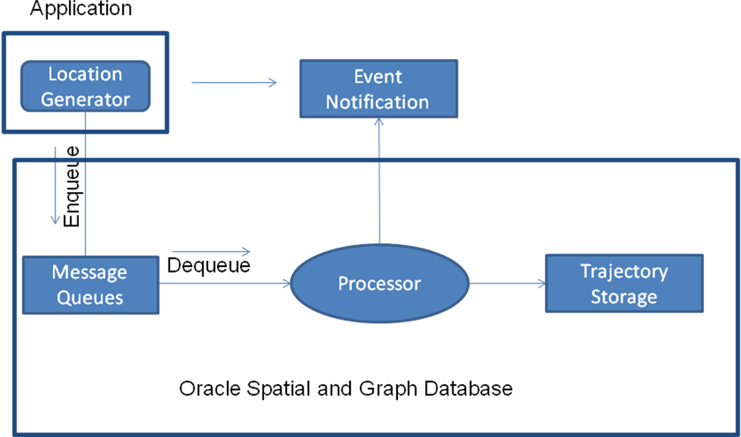
Location tracking in Oracle 12.2
New APIs in Oracle 12.2
Tracking many moving objects against many regions
Enhanced „point-in-polygon“ analysis
  Tracking multiple objects simultaneosly through parallelelism
  Designed to scale to millions of objects
Java API and PL/SQL API for event capture and processing
  Using Advanced Queuing in database for performance and async. processing

Slide 15
Location Tracking API workflow
Create regions of interest in database as polygon geometries
Initialize the location tracking server
  Initialization of 3 queues: one for receiving location objects, one for receiving location messages, and one for storing the notifications after the locations are processed
  Each location object (moving item) has many location messages, can be persisted
PL/SQL APIs to create location objects and insert location messages
Java Applications can use AQ Java API to insert data into the input queues
  JMX queues used for maximum performance
Alerts are sent to output queue
  Subscription to output queue for further processing

Slide 16
SDO_TRKR PL/SQL Package
Setup
  CREATE_TRACKING_REGIONS: Define the tracking region(s)
  START_TRACKING_REGIONS: Starts the queues for the location tracking server and starts jobs to monitor those queues.
  SEND_TRACKING_MSG: Specify which object(s) to track against which region(s)
Process messages from tracked objects
  SEND_LOCATION_MSGS: Send one or more location messages to the location server.
Process notifications
  Subscribe to <TR_REGION>_NOTIFICATION_Q queue for alerts that are generated from the tracking server for a given region

Slide 17
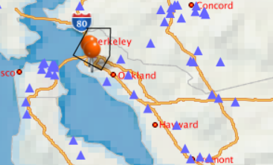
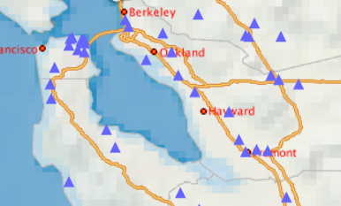
Location Tracking – Use cases
Raise alert when object enters area-of-interest
Raise alert when object leaves area-of-interest (Geofencing)

Slide 18
Agenda
1
Geospatial Data in the Database
Using the Database for Tracking and Tracing
Visualizing Results on a Map
Advanced Analysis using Road Networks
Stream Analytics and Event-driven Architectures
2
3
4
5

Slide 19
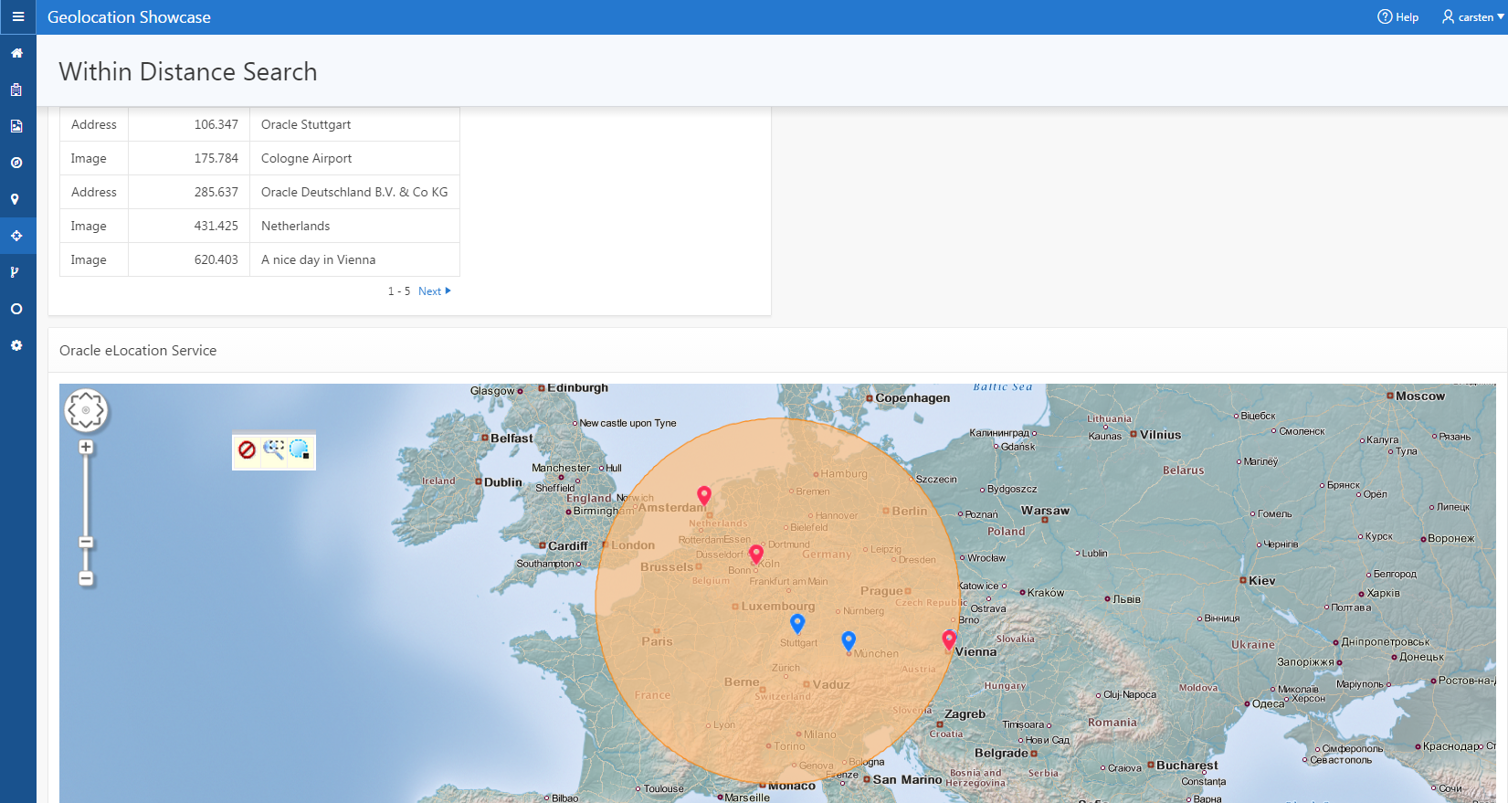
Visualizing Relevant Events in Context
HTML5-based visualization component
  Included in Spatial and Graph license
Rendering dynamic maps
  Data from database
  Data from external sources (WMS, WFS, GeoRSS, WMTS)
  Integration of Google Maps, etc.
Available as plug-in for Apex
  Geolocation Showcase
Many 3rd Party Tools available as well
  eg. Luciad RIA, working with OracleJET

Slide 20
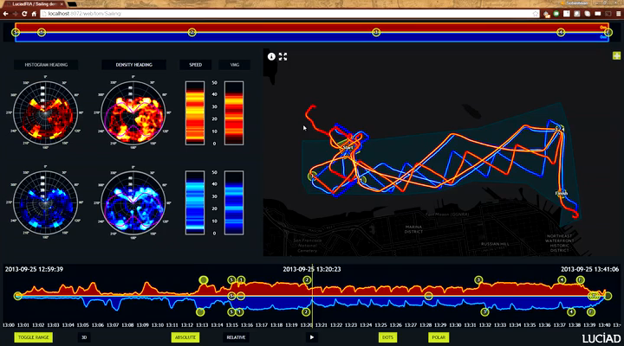

Slide 21
Agenda
1
Geospatial Data in the Database
Using the Database for Tracking and Tracing
Visualizing Results on a Map
Advanced Analysis using Road Networks
Stream Analytics and Event-driven Architectures
2
3
4
5

Slide 22
Tracking und Tracing based on Road Network
Object position not sufficient in all cases, but position on road network required
  eg. exact route needed, despite GPS inaccuracies/errors
  eg. route planning, calculating (remaining) drivetime
Road network as reference dataset needed
  Commercially available from HERE, Tomtom
  OpenStreetMap converter available from CISS TDI
Required database functionality
  Support for linear coordinate systems
  Network data model (graph), routing engine

Slide 23
Routing based on Network Data Model
Entire road network stored as nodes and edges of a graph
  With or without road segment geometry
Connectivitiy and cost (eg. drivetime) per road segment
Enabling network analysis
  Using graph algorithms
  Based on directed or undirected graph
  Optionally taking cost into account
Data Management API
  Caching, Partitioning, load-on-demand, ...
A
B
C
D
E
F
G
H
I
Nearest neighbor in a directed graph

Slide 24
Routing based on Network Data Model: Architecture
Persistent Network
User Application
Network
Analysis
API
Memory-resident Network
Java runtime to keep network in memory (at least partially)
Java API for analytic functions on network graph
Network can be hierarchically organized and partitioned
  Load-on-demand API manages network caching

Slide 25
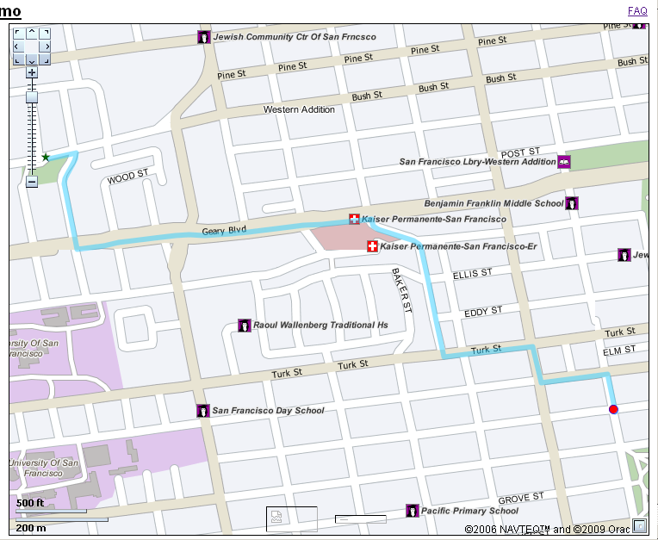
Network Data Model: Analysis
Shortest path analysis
Nearest neighbor analysis
Within cost analysis
Network Buffer (forward and reverse)
Reachable/Reaching nodes
K-shortest paths analysis
Traveling salesman problem
Multiple TSPs/Single Depot (new)

Slide 26
Time Support for Routing Engine
Routing Engine understands date and time
  Temporal constraints and temporal penalty
Specify start date/time in route request
  start_date, start_time, date_format, time_format,
The result will show arrival date/time
  At intermediate and end points.
  return_route_time, return_subroute_time,
Uses Time Zone Data
<?xml version="1.0" standalone="yes"?>
<route_request id="1"
route_preference=”fastest"
return_driving_directions="true“
distance_unit="mile”
time_unit="minute”
start_date=“05-Aug-2016”
start_time=“10:41”
return_route_time=“true”
return_route_geometry="false">
<start_location>
...
</start_location>
<end_location>
...
</end_location>
</route_request>

Slide 27
Routing Using Traffic Patterns
Requires Traffic Patterns in data set
Specify a start date/time in route requests
Specify that you want to use traffic patterns
  route_preference=traffic
Choose traffic sampling precision
  traffic_sampling_id=1 (15 minutes) or 2 (hour)
Route optimization is based on traffic and time
<?xml version="1.0" standalone="yes"?>
<route_request id="1"
route_preference=”traffic"
return_driving_directions="true“
distance_unit="mile”
time_unit="minute”
start_date=“05-Aug-2016”
start_time=“10:41”
return_route_time=“true“
traffic_sampling=“1”
return_route_geometry="false">
<start_location>
...
</start_location>
<end_location>
...
</end_location>
</route_request>

Slide 28

INM Spatial Data Warehouse
Institute for Emergency Medicine and Management in Medicine
Emergency Services Planning in Bavaria
  State-wide planning and optimization
  Site planning for ambulance bases, What-if analysis, ...
Based on 2TB data warehouse of emergency mission data
  Location and status information plus medical data
Combined with road network data, hospital locations, helicopter bases, ...
  Including individual speed profiles per road segment
Calculating drive-time areas, hospital service areas, ...
  Simulation model, ensuring compliance with legal mandate

Slide 29
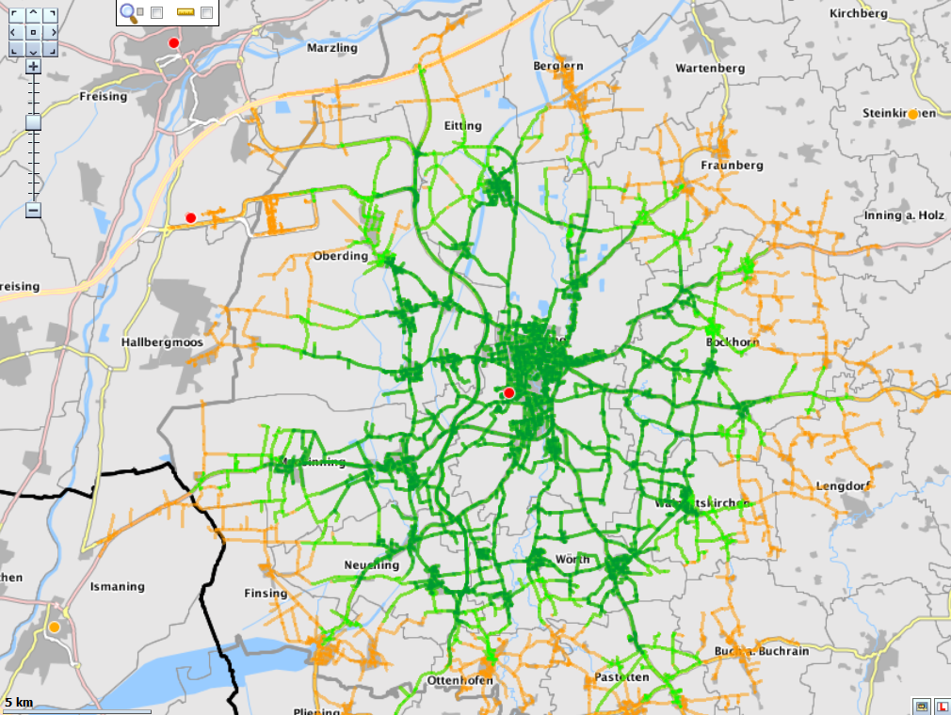
INM Spatial Data Warehouse
Determining drivetime area based on road network

Slide 30
Agenda
1
Geospatial Data in the Database
Using the Database for Tracking and Tracing
Visualizing Results on a Map
Advanced Analysis using Road Networks
Stream Analytics and Event-driven Architectures
2
3
4
5

Slide 31
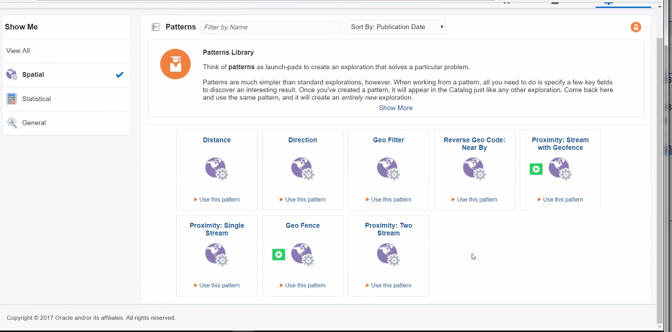
Oracle Stream Analytics for more demanding cases
Complex event processing
  Streaming data correlation and aggregation
  Pattern Matching
  Spatial Analytics
  Machine Learning probability scoring
  Graphical Visualization
Event-driven architecture
  Application development with zero coding
Based on messaging integration
  Kafka support
Various location-related patterns prebuilt

Slide 32

OSCARS GeoIntelligence Platform (GIP) at Liège Airport
French Oracle Users Group Innovation Award, 2017

Slide 33
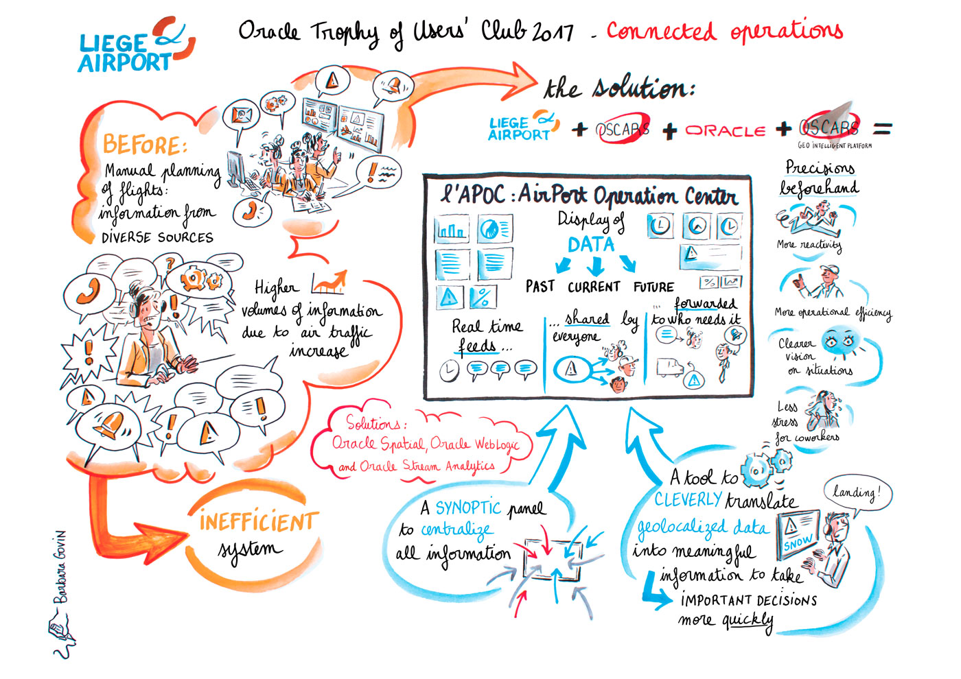

Slide 34

OSCARS GeoIntelligence Platform (GIP) at Liège Airport
Summary
Real-time platform to track movements of all vehicles
  Integrated data platform for all relevant consumers of information
Event-driven Architecture with Rules Engine
  Based on Oracle Spatial and Graph, Weblogic, Stream Analytics
Targeted distribution of relevant events in real-time
  Faster and better decisions
  Regulatory compliance
Simple extension to other data sources
  Could even be used to track individual passengers

Slide 35
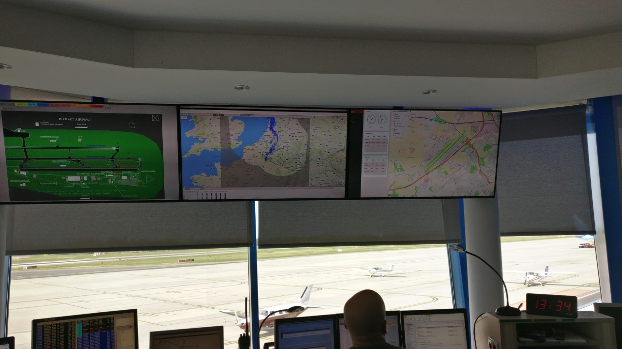


Slide 36
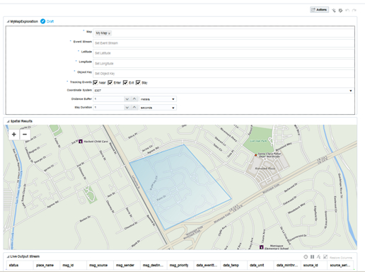
Oracle Internet of Things (IoT) Cloud Service
Event-driven Architecture
  Built on top of Stream Analytics
Simplified application development, no coding required
  Support for different sensor types
  Including device management
  Comprehensive analytics
  Application integration
Geospatial design patterns included
  Location-related events pre-defined (enter, exit, near, stay)
  Definition of areas-of-interest integrated

Slide 37
Wrap-up

Slide 38
The Forrester Wave™:
Geospatial Analytics Tools And Platforms, Q3 2016
“While hardcore GIS professionals may start their work in other applications, when they want to solve spatial problems in production and with web- and IoT- scale data, Oracle gives them
the platform to do so.”
Analysts: Rowan Curran with Holger Kisker, Ph.D.
and Emily Miller
September 1, 2016
The Forrester Wave™ is copyrighted by Forrester Research, Inc. Forrester and Forrester Wave™ are trademarks of Forrester
Research, Inc. The Forrester Wave™ is a graphical representation of Forrester's call on a market and is plotted using a detailed
spreadsheet with exposed scores, weightings, and comments. Forrester does not endorse any vendor, product, or service depicted
in the Forrester Wave. Information is based on best available resources. Opinions reflect judgment at the time and are subject to change.
Notes:
This is a sample Picture with Caption Layout slide ideal for including a picture with a brief descriptive statement.
To Replace the Picture on this Sample Slide (this applies to all slides in this template that contain replaceable pictures)
Select the sample picture and press Delete. Click the icon inside the shape to open the Insert Picture dialog box. Navigate to the location where the picture is stored, select desired picture and click on the Insert button to fit the image proportionally within the shape.
Note: Do not right-click the image to change the picture inside the picture placeholder. This will change the frame size of the picture placeholder. Instead, follow the steps outlined above.

Slide 39

Interested in project experience, best practices, networking?
Spatial and Graph Summit
IOUG Business Intelligence, Warehousing and Analytics SIG have established annual BIWA Summit
  Rebranded as Analytics and Data Summit
  Planned for March 12 – 14, 2019 at OracleHQ
Spatial and Graph Summit is separate track
  Lots of interesting material from previous
  years available on OTN
Opportunity for interaction with
Spatial PM and Dev‘t team

Slide 40
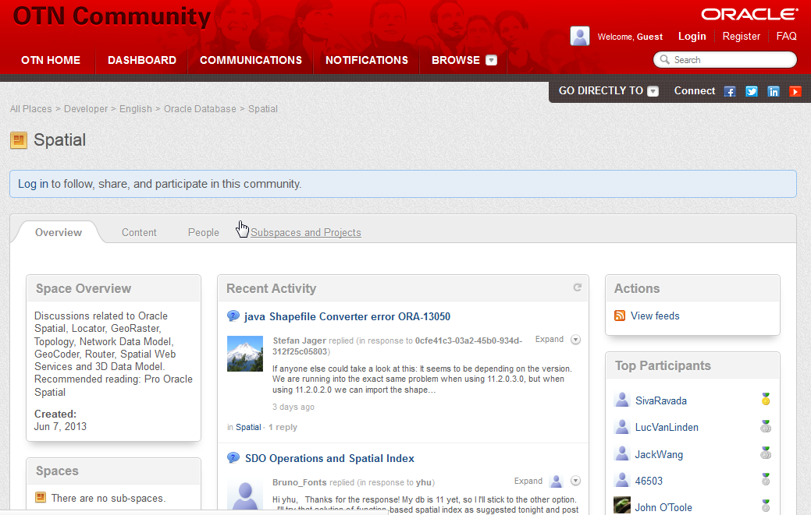
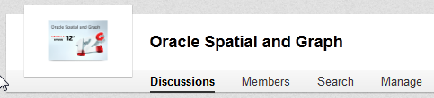

More resources
Further information on oracle.com
  www.oracle.com/goto/spatial
Blogs
  https://blogs.oracle.com/oraclespatial
Developer forums on OTN
  https://community.oracle.com/community/database/oracle-database-options/spatial
Social Media
  LinkedIn: „Oracle Spatial and Graph“ group
  Google+: „Oracle Spatial and Graph SIG“
  Twitter: @SpatialHannes, @agodfrin, @JeanIhm

Slide 41
Q&A

Slide 42


ALBERT GODFRIND
Spatial and Graph Solutions Architect
Oracle Corporation
Les Algorithmes
2000 Route des Lucioles
06410 Biot-Sophia-Antipolis
France
phone +33 4 37.43.47.27
mobile +33 6 09.97.27.23
albert.godfrind@oracle.com
http://www.oracle.com/

