Slide 1
#RepAttack

Slide 2

Who am I
Jan Karremans
In IT since 1991
Oracle SE Round Table founding member
Active member of the Oracle community
Proud member of the Oracle ACE program

Slide 3
What is it
Hands on!
After a flying intro
Logical data replication
Principles apply to all vendors
Dbvisit Replicate because of ease of use

Slide 4


Two Replication Types
Physical Replication
“One on one” copy of the primary database in permanent recovery
Use redo apply to keep up to date
100% binary copy, database are exact replicas
Referred to as a standby database
Best suited for DR
Logical Replication
Independent 2nd database in sync by replication mechanism
Uses SQL statements to keep up to date
Subset of data is replicated
Cross version, cross platform
Separate physical database structure
Best suited for information sharing, migrations, real-time reporting etc

Slide 5

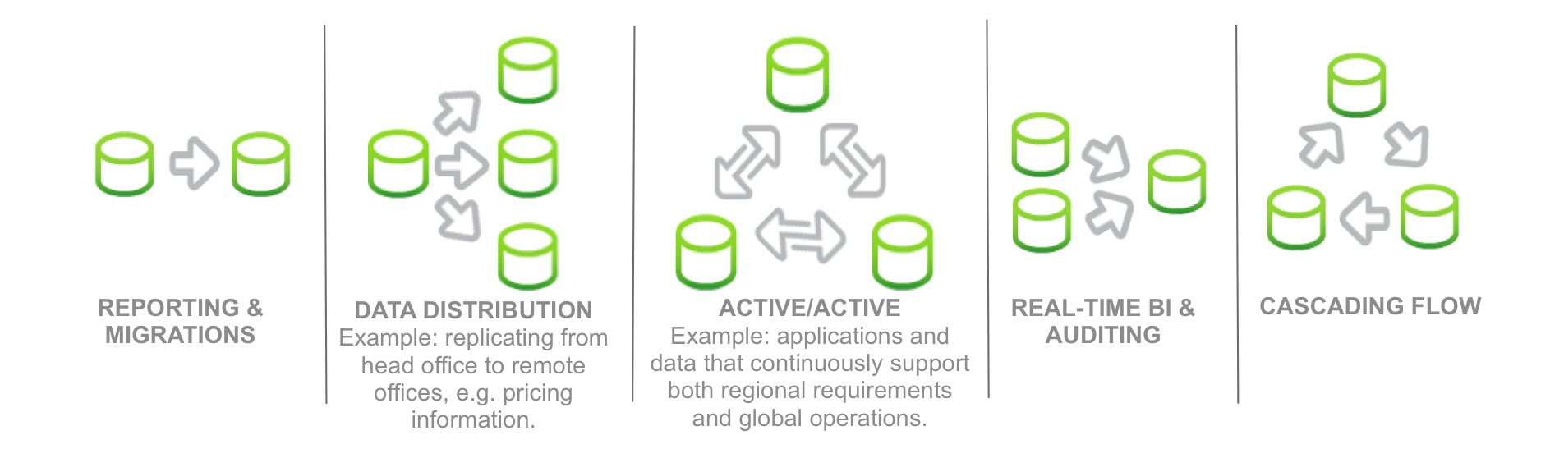
Dbvisit Replicate overview

Slide 6
Dbvisit Replicate overview
Logical data replication to Oracle, MySQL and SQL Server
Real-time, low impact, low latency replication
External to the database
Conflict detection, handling and resolution
Uses proprietary Dbvisit Log Mining technology
No triggers, or changes to the database required
Easy to install, configure, use and manage
Wizard driven operation

Slide 7
Dbvisit Replicate overview
Replicates both:
  DML (data changes)
  DDL (table and column structure changes)
1-way and 2-way replication
Full conflict detection, notification and resolution built-in
Target data instantiation
Replicate to cloud targets such as AWS EC2 and RDS
Replication console to give complete overview

Slide 8



Dbvisit Replicate Architecture
① Mine
  Mines Oracle redo logs and creates PLOG data to move over network
①
Source
Environment
Notes:
Need LAN above WAN INTERNET logo. Need an on-brand arrow for the 1, 2, and 3 circle arrow. Need TARGET REPORTING DATABASE changed to read simply TARGET DATABASE.

Slide 9


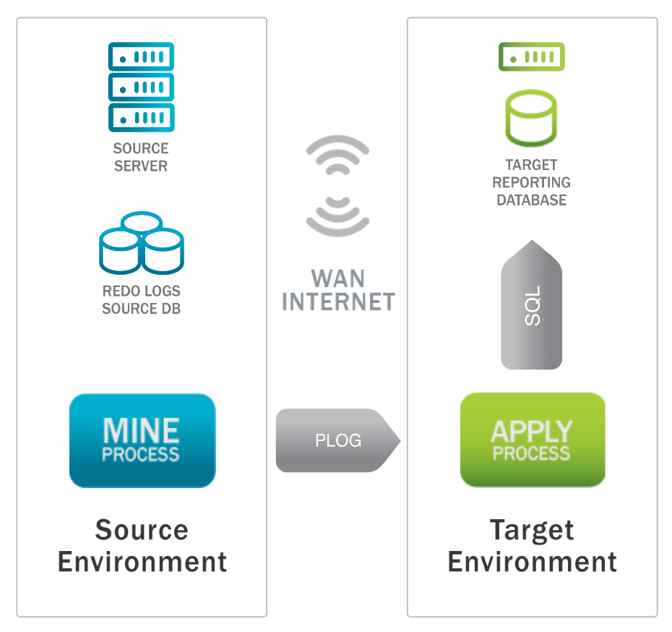
Dbvisit Replicate Architecture
LAN
① Mine
  Mines Oracle redo logs and creates PLOG data to move over network
② PLOG
  - Parsed logs – binary files specific to Dbvisit Reporting
  - Platform independent
①
②
Source
Environment
Notes:
Need LAN above WAN INTERNET logo. Need an on-brand arrow for the 1, 2, and 3 circle arrow. Need TARGET REPORTING DATABASE changed to read simply TARGET DATABASE.

Slide 10

Dbvisit Replicate Architecture
LAN
① Mine
  Mines Oracle redo logs and creates PLOG data to move over network
② PLOG
  - Parsed logs – binary files specific to Dbvisit Reporting
  - Platform independent
③ Apply
  Converts PLOG data into target DB native SQL
①
②
③
Source
Environment
Target
Environment
Notes:
Need LAN above WAN INTERNET logo. Need an on-brand arrow for the 1, 2, and 3 circle arrow. Need TARGET REPORTING DATABASE changed to read simply TARGET DATABASE.

Slide 11
Offload MINE using “Fetcher”
LAN
① Mine
  Mines Oracle redo logs and creates PLOG data to move over network
② PLOG
  - Parsed logs – binary files specific to Dbvisit Reporting
  - Platform independent
③ Apply
  Converts PLOG data into target DB native SQL
④ Fetcher (optional)
  - Offloads Mine process from Source server onto intermediary server
④
①
②
③
Source
Environment
Target
Environment
Notes:
Need LAN above WAN INTERNET logo. Need an on-brand arrow for the 1, 2, and 3 circle arrow. Need TARGET REPORTING DATABASE changed to read simply TARGET DATABASE.

Slide 12
Offload APPLY
LAN
① Mine
  Mines Oracle redo logs and creates PLOG data to move over network
② PLOG
  - Parsed logs – binary files specific to Dbvisit Reporting
  - Platform independent
③ Apply
  Converts PLOG data into target DB native SQL
①
②
③
Source
Environment
Target
Environment
Notes:
Need LAN above WAN INTERNET logo. Need an on-brand arrow for the 1, 2, and 3 circle arrow. Need TARGET REPORTING DATABASE changed to read simply TARGET DATABASE.

Slide 13
Offload both MINE and APPLY
LAN
① Mine
  Mines Oracle redo logs and creates PLOG data to move over network
② PLOG
  - Parsed logs – binary files specific to Dbvisit Reporting
  - Platform independent
③ Apply
  Converts PLOG data into target DB native SQL
④ Fetcher (optional)
  - Offloads Mine process from Source server onto intermediary server
④
①
②
③
Source
Environment
Target
Environment
Notes:
Need LAN above WAN INTERNET logo. Need an on-brand arrow for the 1, 2, and 3 circle arrow. Need TARGET REPORTING DATABASE changed to read simply TARGET DATABASE.

Slide 14

Bidirectional replication
LAN
① Mine
  Mines Oracle redo logs and creates PLOG data to move over network
② PLOG
  - Parsed logs – binary files specific to Dbvisit Reporting
  - Platform independent
③ Apply
  Converts PLOG data into target DB native SQL
PLOGS
①
②
③
Source
Environment
Target
Environment
Notes:
Need LAN above WAN INTERNET logo. Need an on-brand arrow for the 1, 2, and 3 circle arrow. Need TARGET REPORTING DATABASE changed to read simply TARGET DATABASE.

Slide 15
Dbvisit Replicate and RDS

Slide 16
Dbvisit Replicate Architecture
One way replication

Slide 17
Replicate Attack - Setting up replication
  Requires Oracle_Developer_Day11g.ova image
  Requires Virtual Box
  Minimum 4G RAM
  Cook book:
    https://dbvisit.atlassian.net/wiki/display/REPA11XENOS/RepAttack+11g+XE+Home
    !! Or just search for 'repattack download link’ !!

Slide 18
Implications of Oracle redo log mining replication
  Set based SQL operations on the source database are
  converted to row-by-row SQL changes on the target database.
  Why?
  This is the way that Oracle writes to the Redo
  Redo does not contains SQL, it has to be reconstructed from LCRs
  Observations:
  SQL is not the same on source as on target
  True for all logical replication based solutions
  Each SQL on target only affects 1 row
Notes:
The replication is a row-based which means that the changes are mined row-by-row on the mine. While any SQL issued on the source database can change arbitrary number of rows, Dbvisit Replicate will only affect changes made to individual rows. The consequence is that the SQL issued at the apply database is not the same issued against mine – instead, each SQL updates/deletes/inserts exactly one row, applying just one change.
Why is this – this is the way that the information is in the redo logs.
it is possible to do a SQL-based replication (instead of row-based). It's quite hard to do it on Oracle (with all the concurrency and timing); note that e.g. mysql is much more friendly to support it. Then you just reply the source SQLs (similar to Real Application Testing - workload reply).

Slide 19
Implications of Oracle redo log mining replication
Source | Target
update PRICES set PRICE = PRICE - (PRICE * .10) where PRODUCT_CAT = 'OLD_STOCK'; | update PRICES set PRICE = 10 where PROD_ID = 101;
 | update PRICES set PRICE = 23 where PROD_ID = 102;
  Observations:
  Source SQL updates 2 rows, then 2 individual update statements are produced
  PK has been added to the WHERE to ensure row-by-row
  Price formula has been replaced by hardcoded value
Notes:
The replication is a row-based which means that the changes are mined row-by-row on the mine. While any SQL issued on the source database can change arbitrary number of rows, Dbvisit Replicate will only affect changes made to individual rows. The consequence is that the SQL issued at the apply database is not the same issued against mine – instead, each SQL updates/deletes/inserts exactly one row, applying just one change.
Why is this – this is the way that the information is in the redo logs.
Notice that the target SQL has the primary key (PROD_ID) added to the WHERE statement. Adding the primary key will ensure that the target SQL only updates one row at a time.If the source SQL updates 100 records in a single SQL statement, then the target SQL will consist of 100 single SQL statements each with the unique primary key added.It can be seen that having a primary key on the table to be replicated becomes very important. This allows the resulting target SQL to add the primary to the WHERE clause to ensure only one rows gets updated at a time.What if the table to be replicated does not have a primary key? Does that mean we cannot replicate this table using logical based replication?The answer is no. In most cases we will still be able to replicate the table if there is no primary key, but this depends on principle number 2

Slide 20
Components of Dbvisit Replicate
  Software
  DDC
  Setup wizard
  Configuration scripts
  Dbvisit Replicate processes

Slide 21
Dbvisit Replicate Software
Software Installation
RPM on Linux
Tar on Unix
Windows installer on Windows
Installed executables
dbvrep
Includes Oracle client software

Slide 22
Replicate Console
  View and manage the replication
  Normally run on source system
  Can be run on any system with
      Dbvisit Replicate installed (dbvrep)
      Tnsnames.ora
  Connect to source and target database with TNS
  Shortcut script created by wizard: start_console.sh

Slide 23
DDC - Dbvisit Database Configuration settings
  Parameter file for Dbvisit Replicate
  Two types
      DDC = init.ora equivalent for Dbvisit Replicate
      DDC DB = spfile equivalent for Dbvisit Replicate
  Most settings are stored in the database
      Small file based DDC file needed to point to DDC DB in database
  Set global or per process (like RAC)
      *.NOTIFY_SCN_DIFFERENCE = 1000
      MINE.NOTIFY_SCN_DIFFERENCE = 10
      APPLY.NOTIFY_SCN_DIFFERENCE = 20

Slide 24
Setup wizard
  Configure a new replication
  Question and answer format
  Remembers the previous inputs
  Does not make any changes to the database
  Generates replication scripts that are run to initialize and start the replication
    dbvrep> setup wizard

Slide 25
Configuration scripts
  Created by the setup wizard
  *-all.sh or *-all.bat
    Main script, can be rerun at any time to drop and recreate the replication
  *.dbvrep (in config dir)
    Contains all internal dbvrep commands.
  *.sql (in config dir)
    Setup the Oracle environments
  *.cfg (in config dir)
    Setup wizard configuration files
  *.ddc (in config dir)
    DDC files

Slide 26
Replicate configuration settings
  Wizard can be run again
      When same DDC is used, existing values are picked up
  Settings can be manually adjusted for new environment
      All files can be edited (.dbvrep, .ddc)
      Rerun *all.sh script at any time
  Flexibility
      Scripts can be generated to save time:
      select 'unprepare table ' || owner||.||table_name from user_tables where table_name like 'xxx%';
      Spool the output to a file unprepare.dbvrep
      Then run this against dbvrep:
      ./start-console.sh \@unprepare.dbvrep

Slide 27
Dbvisit Replication processes
  Identify process
  ps -ef | grep dbvrep
  Mine process (start script created by setup wizard)
  dbvrep MINE d1 --daemon --ddcfile /home/oracle/d112f/d112f-APPLY.ddc start MINE
  Apply process (start script created by setup wizard)
  dbvrep APPLY d1 --daemon --ddcfile /home/oracle/d112f/d112f-APPLY.ddc start APPLY
  Killing the processes
  The processes can be stopped with “kill -9”
  To produce trace file “kill -12”

Slide 28
Administration
  Command Console
  Basic commands
  Starting and stopping replication
  Adding new tables

Slide 29
Replicate Console
  View and manage the replication
  Normally run on source system
  Connect to source and target database with TNS
  Shortcut script created by wizard: start_console.sh
  Two parts:
    Status bar
    Command console

Slide 30
Replicate Console
  Action script can be added to start_console.sh
  Similar to SQL*Plus action script:
  start_console.sh @my_replication_commands

Slide 31
Basic commands
  All commands are run in the command console
  list progress
  list stats all
  help
  show all
  set

Slide 32
Setting variables
  set
  Updates DDC DB and is permanent to the replication including restarts
  Usually requires restart of process
  set PROFILER /home/oracle/dbvrep/log/prof_%S.%
  memory_set *
  Only set for running process. Used to set variables in DDC file.
  memory_set PROFILER /home/dbvrep/log/prof_%S.%E
  send command
  Direct set command (without having to stop Mine or Apply)
  engine mine send memory_set PROFILER /home/dbvrep/log/prof_%S.%E
  * Recommended for method for setting most variables

Slide 33
Starting and stopping replication
  Stopping
  Shutdown from console
    dbvrep> shutdown all
  Killing the dbvrep process with ‘kill -9’
  Starting
  Startup using the scripts provided
    ./<replication_name>-run-<hostname>.sh
    Example: ./d112f-run-dbvisit230.dbvisit.com.sh
  Manually
    dbvrep --daemon --ddcfile /home/oracle/d112f/d112f-APPLY.ddc start APPLY

Slide 34
Prepare and unprepare tables
  Wizard is used to select tables and schemas to be replicated
  When schema is prepared all new tables are automatically replicated (if DDL is turned on)
  Table can be removed with unprepare
  dbvrep>UNPREPARE TABLE scott.dept
  New tables, schemas can be added with prepare*
  PREPARE [AS OF scn] SCHEMA schema [NODDL [RENAME TO newschame]]
  PREPARE [AS OF scn] TABLE schema.table [NODDL [RENAME TO newschema.newtable]]
  Example:
  dbvrep>prepare table scott.dept
  * Enables supplemental logging on primary keys

Slide 35
Monitoring
  Conflicts and conflict resolution
  How do I know my data is in sync
  Notification
  Setting thresholds

Slide 36
Conflicts and conflict resolution
  Conflict detection
      dbvrep> show conflict
  Conflict resolution
      dbvrep> resolve conflict
  Conflict handling
      set predefined rules to say what to do when a conflict occurs (includes setting PL/SQL business rules)
      dbvrep> set_conflict_handlers
      dbvrep> show_conflict_handlers

Slide 37
Conflicts principle - Identification
  For the data in the table to be successfully replicated, each row in the source table must be uniquely identified
  To uniquely identify each row, ONE of the following must be true:
  Primary key
  Unique key
  All data in columns in row must produce a unique result
  If none are true, then table replication may cause conflicts
Notes:
Unique Key must have at least one NOT NULL column

Slide 38
When is data in sync
  Progress shows 100% complete
  No conflicts
  Setup correct thresholds
Data divergence
When data differences occur between source and target environments
Can use DBMS_COMPARISON to compare both datasets and generate SQL for the differences

Slide 39
Notifications settings
  *.NOTIFY_SEND_HEARTBEAT_TIME24 = 0800:1300
  *.NOTIFY_DAILY_LIST_PROGRESS_TIME24 = 0700
  *.NOTIFY_PROGRESS_DIFFERENCE_PERC = 10
  *.NOTIFY_PEER_DOWN = ALL
  *.NOTIFY_TIME_DIFFERENCE = 300
  *.NOTIFY_ALL_EMAIL = dba@mycompany.com
  *.NOTIFY_SCN_DIFFERENCE = 1000
  *.NOTIFY_CONFLICT_THRESHOLD = 100
  *.NOTIFY_SUCCESS_EMAIL = OFF
  *.NOTIFY_ALERT_EMAIL = OFF
  *.NOTIFY_SEQUENCE_DIFFERENCE = 10
  *.NOTIFY_EXCEEDED_CYCLE_NUM = 2
  *.NOTIFY_INTERVAL_BETWEEN_CHECK = 5m

Slide 40
Test notifications settings
  Cycle
  NOTIFY_EXCEEDED_CYCLE_NUM = 2 ⬅ Cycles to check before alerting
  NOTIFY_INTERVAL_BETWEEN_CHECK = 5m ⬅ How often to check
  Thresholds
  NOTIFY_PROGRESS_DIFFERENCE_PERC = 10
  NOTIFY_PEER_DOWN = ALL
  NOTIFY_TIME_DIFFERENCE = 300
  NOTIFY_SCN_DIFFERENCE = 1000
  NOTIFY_CONFLICT_THRESHOLD = 100
  NOTIFY_SEQUENCE_DIFFERENCE = 10

Slide 41
Setting thresholds
  Send tests
  dbvrep> help notify
  NOTIFY: Send test notifications.
  NOTIFY SEND HEARTBEAT: force send of the heartbeat email.
  NOTIFY SEND DAILY_PROGRESS: force send of the daily progress email.
  NOTIFY SEND SNMP_TRAP: send a testing PeerDown SNMP trap.
  Debug notifications
  dbvrep> set _NOTIFY_VERBOSE_DEBUG=1
  dbvrep> set _NETWORK_TRAFFIC_DEBUG=1

Slide 42
Trouble Shooting
  Log files
  Plog files
  Support package
  Getting help and contacting support

Slide 43
Log files
  Mine
    $HOME/$DDC/log/dbvrep_MINE_$DDC.log
  Apply
      $HOME/$DDC/log/dbvrep_APPLY_$DDC.log
  Trace files
  $HOME/$DDC/log/trace
DDC=Replication Name. Example: export DDC=d112f

Slide 44
Logs and trace files
  Mine and Apply have logs on respective servers
      dbvrep> show log
      MINE.LOG_FILE = /home/oracle/d112f/log/dbvrep_%N_%D.%E
      APPLY.LOG_FILE = /home/oracle/d112f/log/dbvrep_%N_%D.%E
  Trace files
      MINE.LOG_FILE_TRACE = /home/oracle/d112f/log/trace/dbvrep_%N_%D_%I_%U.%E
      APPLY.LOG_FILE_TRACE = /home/oracle/d112f/log/trace/dbvrep_%N_%D_%I_%U.%E

Slide 45
Plog files
  Mine and Apply have plogs on respective servers
      dbvrep> show log
      MINE.MINE_PLOG = /home/oracle/d112f/mine/%S.%E
      APPLY.APPLY_STAGING_DIR = /home/oracle/d112f/apply
  Obsolete archive redo log files
    List of redo no longer needed by Dbvisit Replicate
    dbvrep> list obsolete redo
  Managing Plog files
      Plogs are automatically removed after they are no longer needed DELETE_OBSOLETE_PLOGS_AGE

Slide 46
Support package
  Support packages contain all the necessary information for Dbvisit Support to diagnose an issue.
  Contains redo, trace and log files, plogs, configurations and repository information
  Support package are automatically on fatal errors
  Can be manually created with
    dbvrep> support package mine
    dbvrep> support package apply
  Can be uploaded to support.dbvisit.com
DDC=Replication Name. Example: export DDC=d112f

Slide 47
Getting help and contacting Dbvisit Support
  Contacting support
  support.dbvisit.com
  To increase turn around time please upload
    Log file
    Any trace files
    Support package

Slide 48
Generic topics
  Data instantiation
  Extra feature - Audit
  Exercises
  Features to try at home
  Help and references

Slide 49
Data instantiation
  By default datapump script is generated
      FLASHBACK_SCN is used
  Rman can also be used to clone database
    SCN of resetlogs is used
  Activated Standby database can be used as target
    SCN of resetlogs is used

Slide 50
Data instantiation
  By default datapump script is generated
  /APPLY.sh Import: Release 11.2.0.3.0 - Production on Wed Nov 14 09:55:17
  Starting "SYSTEM"."DP_D112F_0001": SYSTEM/********@d112f_dbvisit230 table_exists_action=TRUNCATE network_link=d112f_dbvisit210 directory=DATA_PUMP_DIR flashback_scn=36389106 tables=OE.CUSTOMERS,OE.INVENTORIES,OE.LOGON,OE.ORDERENTRY_METADATA,OE.ORDERS,OE.ORDER_ITEMS,OE.PRODUCT_DESCRIPTIONS,OE.PRODUCT_INFORMATION,OE.WAREHOUSES logfile=OE_CUSTOMERS.log JOB_NAME=DP_d112f_0001
  Rman can also be used to clone database
    SCN of resetlogs is used
  Activated Standby database can be used as target
    SCN of resetlogs is used

Slide 51
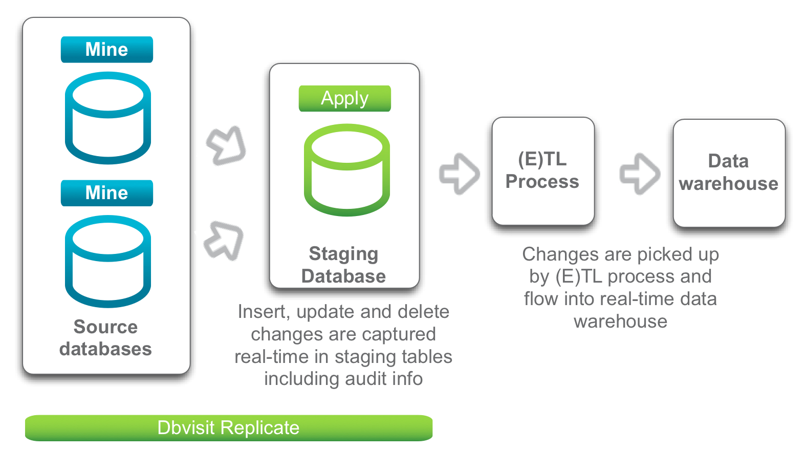
Dbvisit Replicate – feature highlight:
Audit feature for real-time BI (i)
This does not maintain a copy of the source table(s), but logs all operations as separate entries.

Slide 52
Dbvisit Replicate – feature highlight:
CDC/Audit real-time BI (ii)
New row inserted in staging
table for every:
Insert
Update
Delete

Slide 53
Help and references
dbvrep> help
man dbvrep (when installed with rpm)
Online help: http://www.dbvisit.com/content/online/dbvisit_replicate_userguide
Dbvisit Support: http://support.dbvisit.com

